Slide 1
APCSP Exam Terms & Concepts
Coding & Algorithm

Slide 2
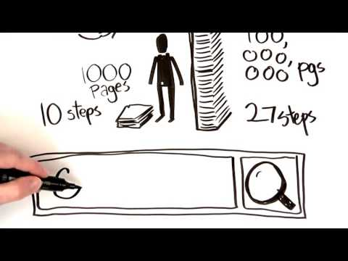
Algorithm
A precise sequence of instructions for processes that can be executed by a computer and are implemented using programming languages
In computer programming it can includes operators like +, - , *, /

Slide 3

Heuristic Algorithm
One that is designed to solve a problem in a faster and more efficient fashion than traditional methods by sacrificing optimality, accuracy, precision, or completeness for speed
Solutions are close to the best one but does not guarantee to be the best solutions
https://studio.code.org/s/csp2/stage/2/puzzle/1

Slide 4
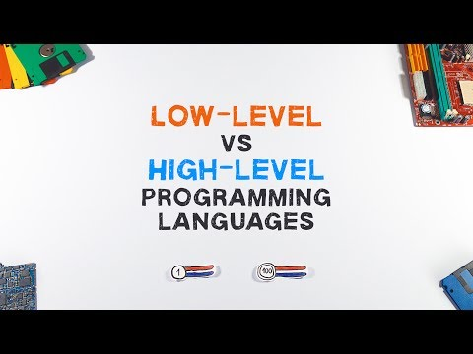
Low Level Programming Language
A programming language that captures only the most primitive operations available to a machine. Anything that a computer can do can be represented with a combinations of low commands
Language that a machine can process, ie. binary
Does not need a compiler or interpreter

Slide 5

High Level Programming Language
A programming language with many commands and features designed to make common tasks easier to program. Any high level functionality is encapsulated as combinations of low level commands.
Any languages that human can process like Python, Java, C, etc…
Needs a compiler and interpreter

Slide 6

Sequencing
Putting commands in correct order so computers can read the commands (or follow the algorithm)

Slide 7
Selection
A generic term for a type of programming statement (usually an if-statement) that uses a Boolean condition to determine, or select, whether or not to run a certain block statements

Slide 8

Conditionals
If, then
If, else
>, <, =
Booleans

Slide 9

Booleans Expression
True/False
<, >, =
<=, >=, ==

Slide 10
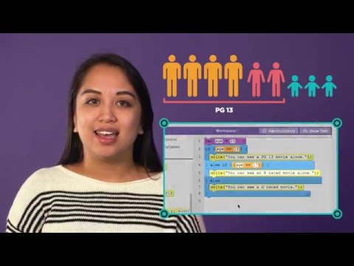
Conditional Statements
If/Else statements
AND/OR statements
AND - both conditions must be true
OR - one conditions must be true

Slide 11
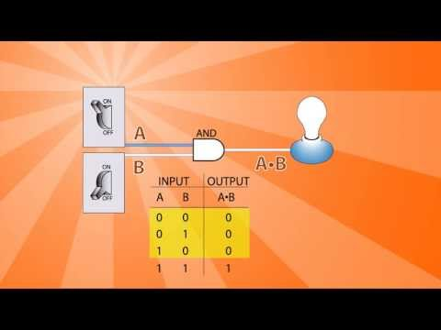
Logic Gates
Use logical operators (AND, OR, NOt)
Which task should be executed and when

Slide 12
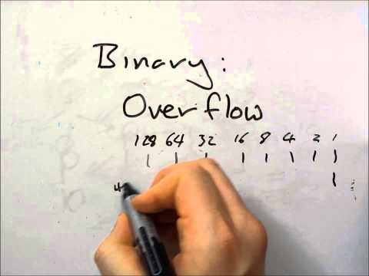
Overflow
Occurs when a computer attempts to handle a number that is too large for its capacity

Slide 13
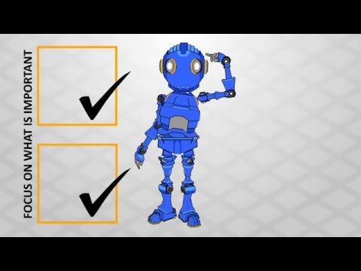
Abstraction
Hiding the details of your code
A simplified representation of something more complex.
Helps you to hide details to manage complexity, focus on relevant concepts, and reason about problems at a higher level.
https://studio.code.org/s/csp3/stage/5/puzzle/6

Slide 14
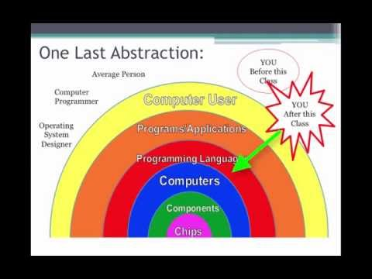
Levels of Abstraction

Slide 15
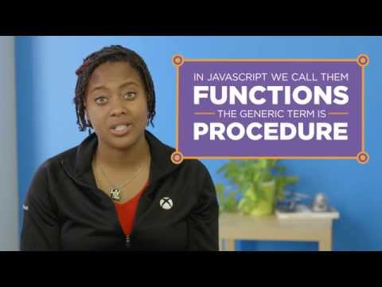
Function
A named group of programming instructions
Functions are reusable abstractions that reduce the complexity of writing and maintaining programs

Slide 16
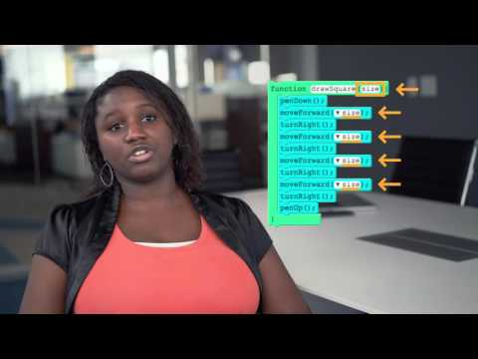
Parameter
An extra piece of information that you pass to the function to customize it for a specific need
Parameter must have a name and input pass through the parameter must be of a datatype (usually a number)
A level of abstarction

Slide 17

Callback Function
Is a function passed into another function as an argument, which is then invoked inside the outer function to complete an action

Slide 18
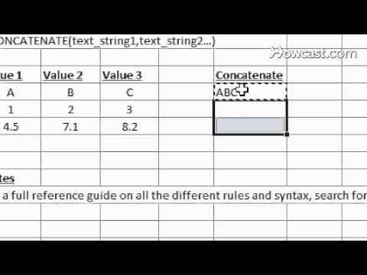
Concatenation
Combining values, usually strings, together

Slide 19
Datatype
Number (floats & integers)
String
Images
Booleans
(Lists)

Slide 20
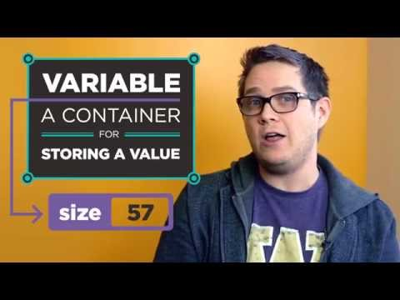
Variable
A place to store information or data
A variable can store any datatype
Usually have a name
And gets an assignment value as input
Global & Local variables
Global var can be accessed by the entire program
Local var can only be accessed by specific function or block in which it was declared

Slide 21
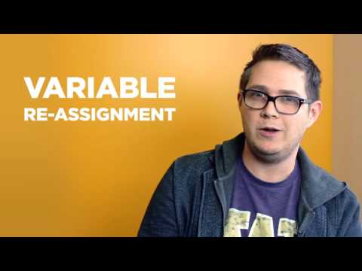
Variable Reassignment
A place to store information or data
A variable can store any datatype
Usually have a name

Slide 22
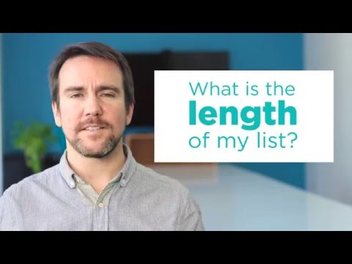
List
A way to give a name to a collection of values or elements
The elements in the list can be of any datatype

Slide 23

Iteration
Looping a function
Calling a function over and over again
Fixed loop (repeat 10)
Infinite loop (forever)
For loop

Slide 24

Loops
Ways of repeating an algorithm, a function, or an abstraction
For loop
While loop
Do while loop
For each loop
Repeat (times) loop
Repeat forever loop

Slide 25
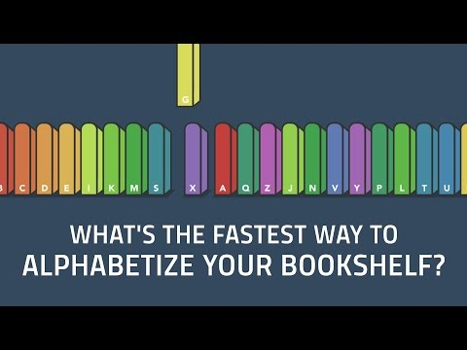
Sorting Algorithms
Quick Sort
Bubble Sort
Insertion Sort

Slide 26

Linear Search
A method for finding an element in an unsorted list by sequentially checking every element on the list
Time-consuming and expensive

Slide 27
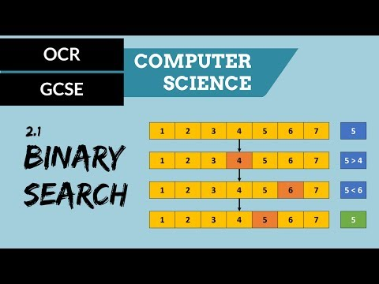
Binary Search
A method for finding an element in a sorted list by continually calculating the midpoint of the list and compare the targeted element to the half lists
More efficient compare to the Linear Search

Slide 28
Top Down Design
A problem solving approach (also known as stepwise design) in which you break down a system to gain insight into the sub-systems that make it up

Slide 29
Documentation
A description of behavior of a command, function, libray, API, etc...

Slide 30
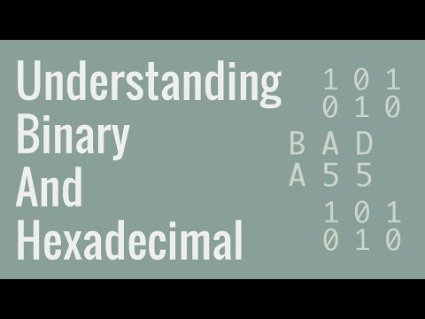
Hexadecimal
Hiding the details of your code

Slide 31
Library
A collection of commands/functions, typically with a shared purpose

Slide 32
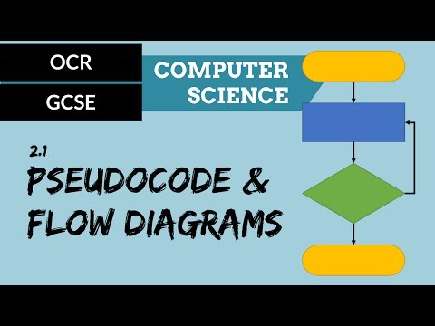
Pseudocode & Flowchart
Simplified programming language that helps us to plan out our algorithms

Slide 33

Algorithmic Efficiency
The measure of amount of time for an algorithm to execute
Depends on the amount of data being transferred

Slide 34

Program Runtime

Slide 35

Simulation
Imitation of a situation or process

Slide 36
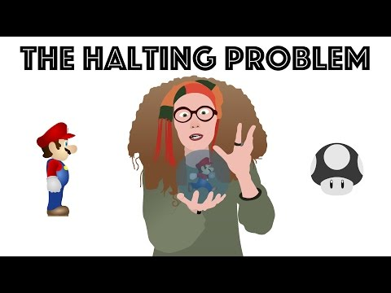
The Halting Problem
The problem of determining whether a program will finish running or will run forever with a hundred percents accuracy
Undecidable or Unsolvable problem

